Slide 1

WIPRO NGA Program – Java Full Stack 25VID1947
Capstone Project Presentation –29th Aug
Project Title Here – Marriage Hall Booking
Presented by – Yash Kumar (user id – 31286)
www.rpsconsulting.in

Slide 2

Project Overview
Digital transformation of Marriage Hall booking operations
Full-stack web application with microservices architecture
End-to-end automation from development to deployment
Cloud-native approach using containerization
2025 - RPS Consulting all rights reserved

Slide 3
Technical Architecture
Frontend Layer
Angular 17 with TypeScript
Material Design UI components
Responsive web interface
Real-time data synchronization
Backend Layer
Spring Boot 3.1.5 with Java 17
RESTful API architecture
Spring Security for authentication
JPA/Hibernate for data persistence
Database Layer
MySQL 8.0 database
Relational data modeling
Automated migrations
Sample data initialization
2025 - RPS Consulting all rights reserved

Slide 4
Core Functionality
Login/signup
Easy Registration and Login
Booking Management
CRUD operations for bookings
Able to view and edit bookings
The final price calculated
Hall management
User able to see halls is grid
Able to view the halls amenities
Quick book the hall
User Profile
User able to see profile
Edit profile
2025 - RPS Consulting all rights reserved

Slide 5
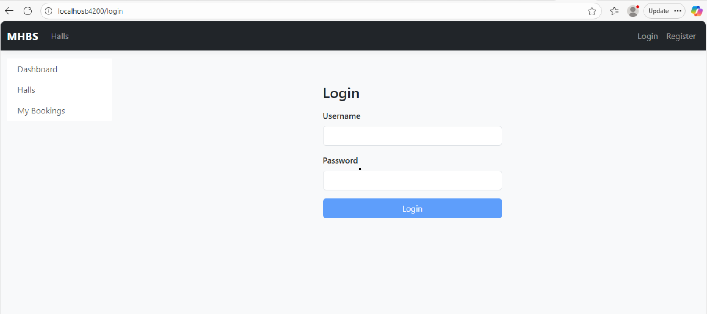
Login/signup Page
2025 - RPS Consulting all rights reserved

Slide 6
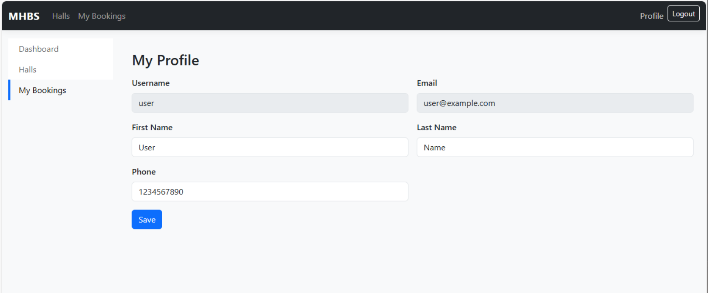
Profile Page
2025 - RPS Consulting all rights reserved

Slide 7
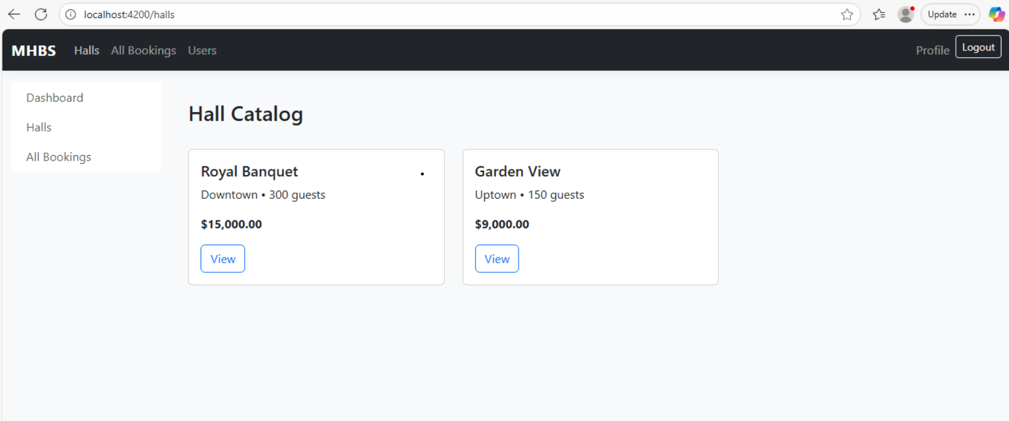
Halls Page
2025 - RPS Consulting all rights reserved

Slide 8
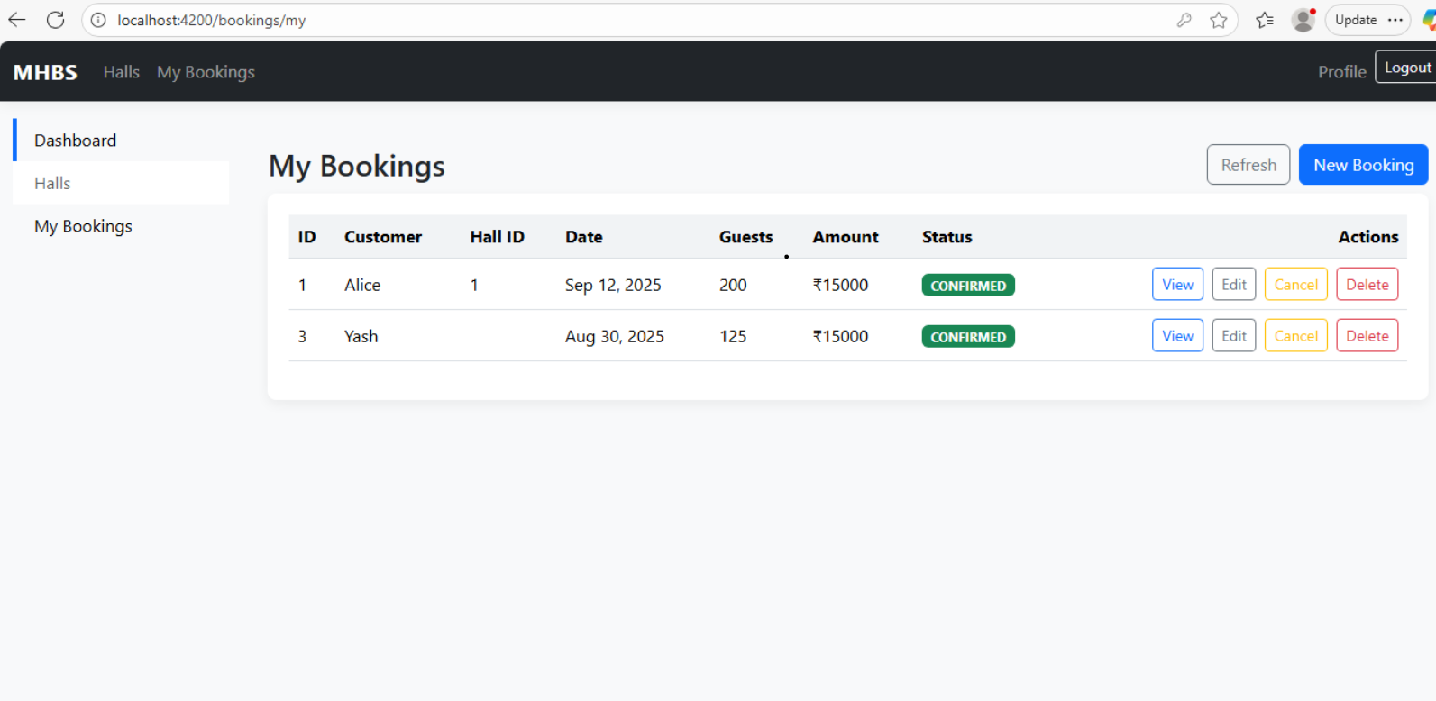
Booking –List
2025 - RPS Consulting all rights reserved

Slide 9
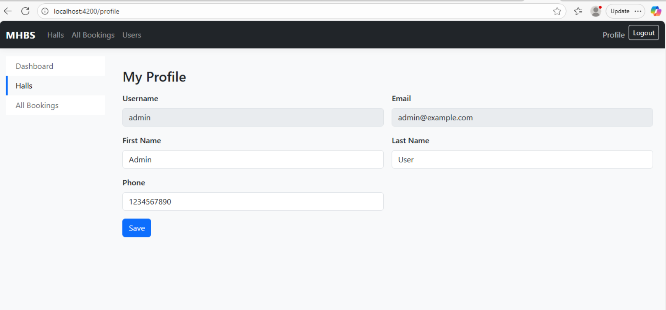
Admin profile
2025 - RPS Consulting all rights reserved

Slide 10
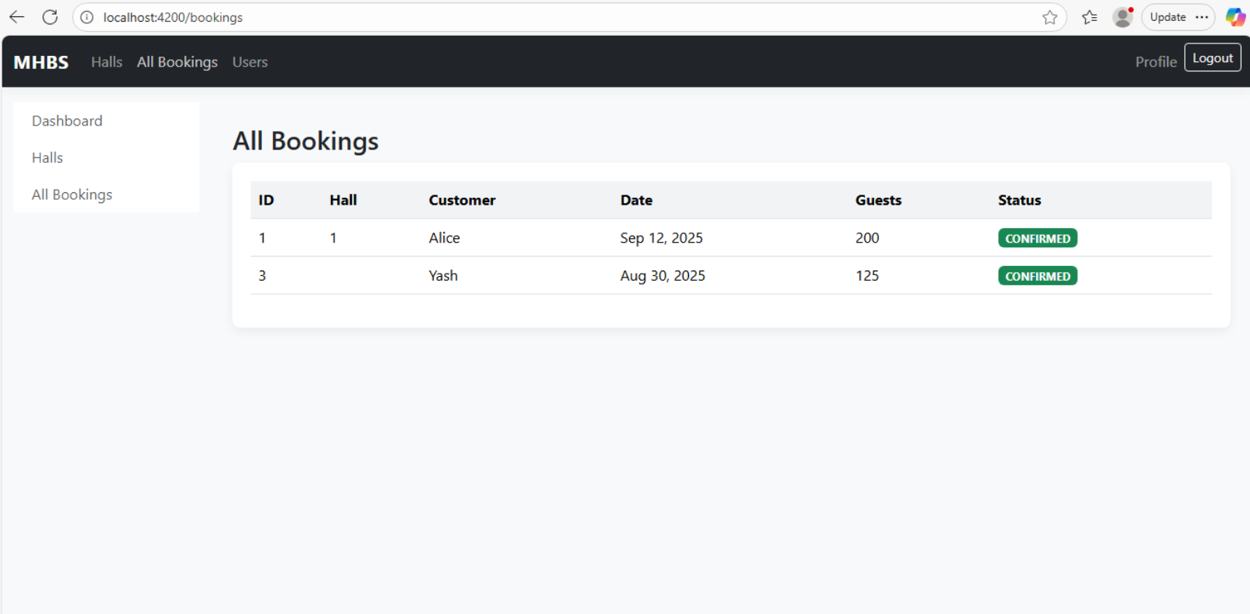
Admins All Bookings preview
2025 - RPS Consulting all rights reserved

Slide 11
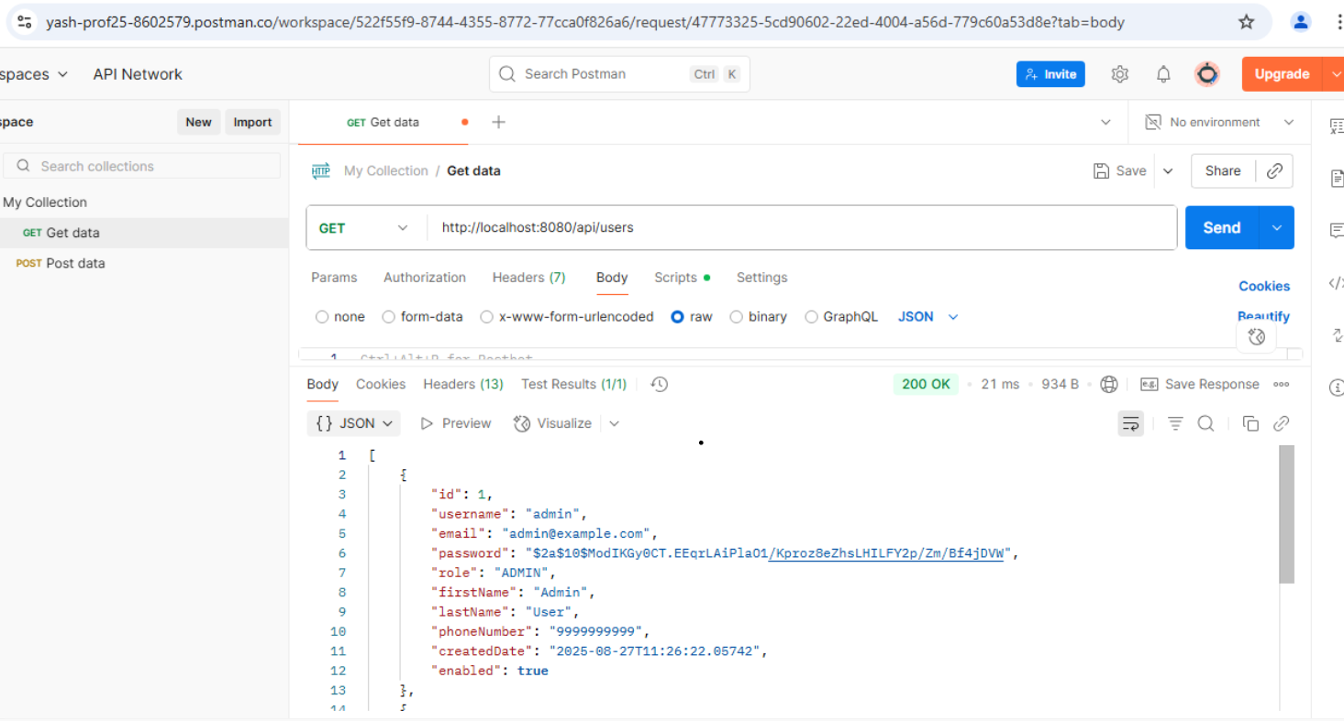
Postman Api Testings
2025 - RPS Consulting all rights reserved

Slide 12
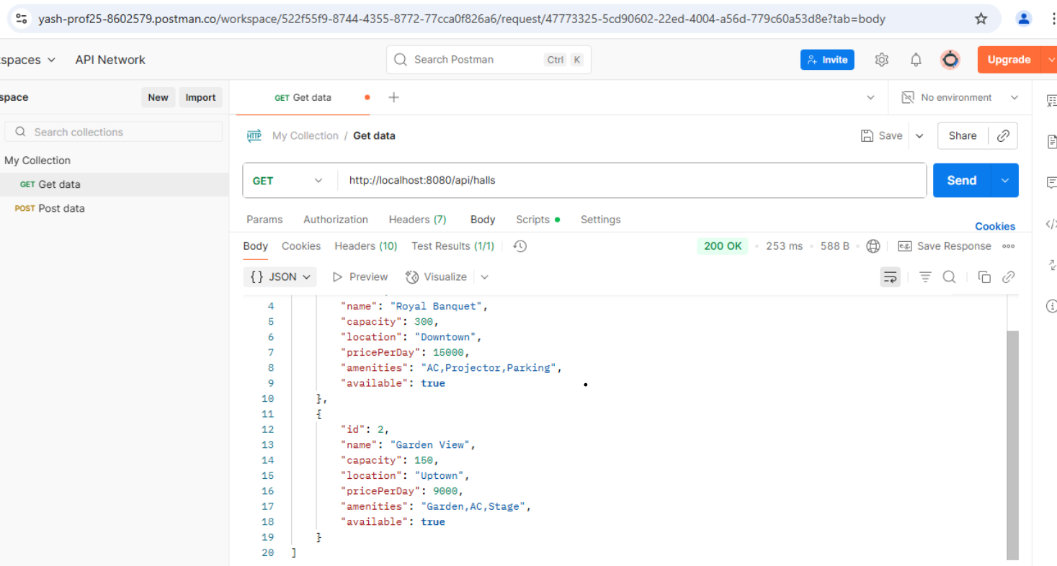
Postman Api testing
2025 - RPS Consulting all rights reserved

Slide 13
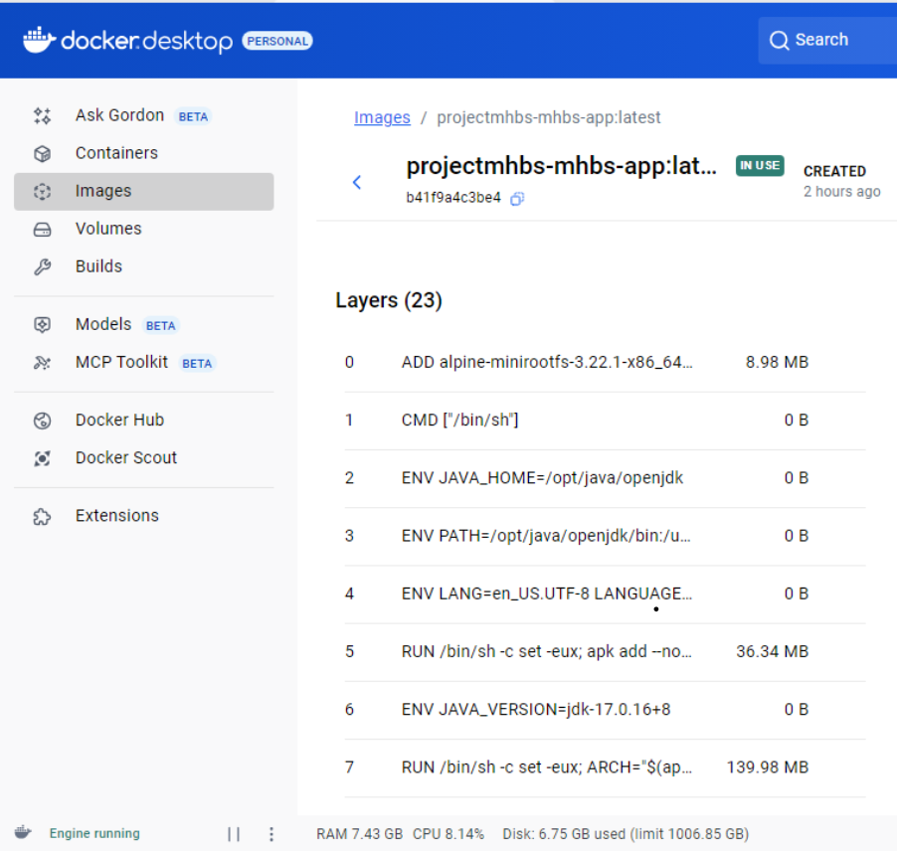
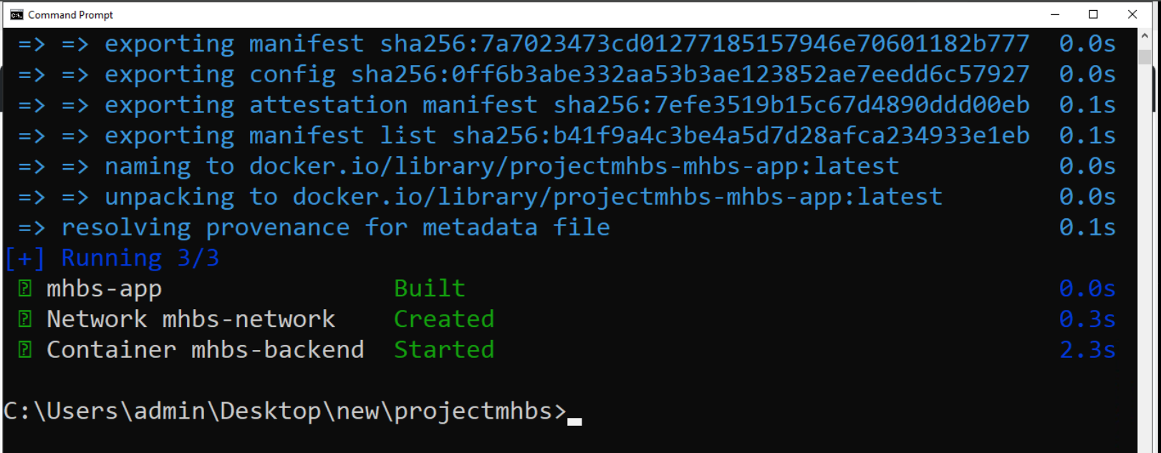
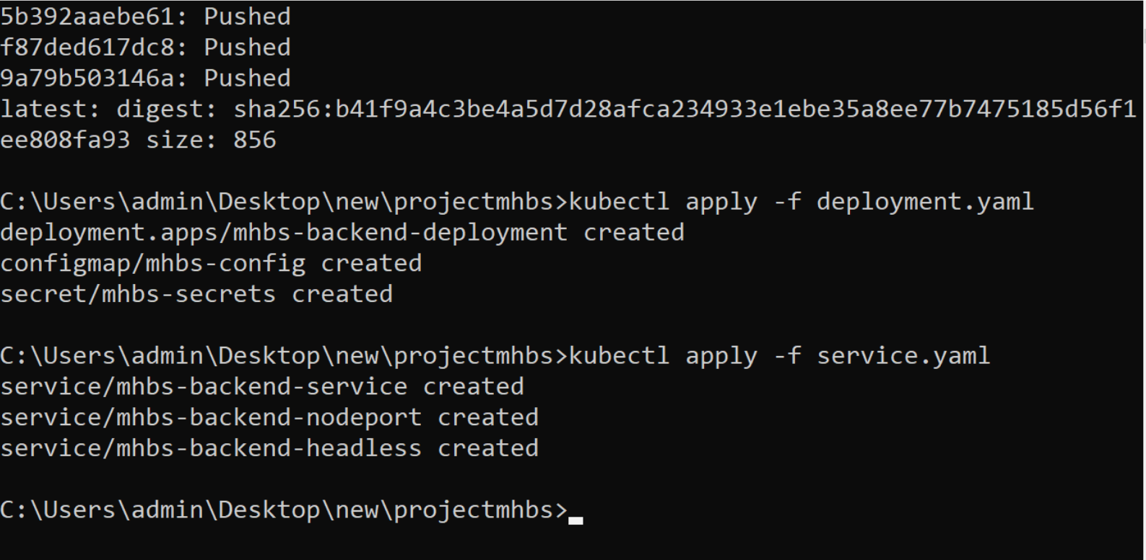
Docker
2025 - RPS Consulting all rights reserved

Slide 14
THANK YOU
www.rpsconsulting.in

